Slide 1
Predictive Analytics (Machine Learning)
Slide Set VI – ML Modeling Josh Bernhard University of Colorado - Denver

Slide 2
Introduction to Machine Learning
The methods described in the previous slide set work along with a modeling algorithm. Choosing a modeling strategy is conditioned on the types of variables you have, and whether you are interested in a supervised or unsupervised approach.

Slide 3

Recommendation Engines, Supervised and Unsupervised Learning Methods
Supervised Learning
Recommendation Engines
Supervised Learning
 | Response variable is:
Predictors are: | Categorical | Quantitative
Categorical | Logistic Regression | Regression
 | Classification Trees | Regression Trees
 | kNN, SVM, Neural Networks, NB | Neural Networks
Quantitative | Logistic Regression | Regression
 | Classification Trees | Regression Trees
 | kNN, LDA, QDA, SVM, Neural Networks, NB | Neural Networks
Recommendation Engines
Recommendation
Based on Association: | MBA/Affinity Analysis
Based on Ratings: | Collaborative Filtering
Variable2
Variable3
Variable1
Unsupervised Learning
Explainer1
Response
Explainer2
Explainer3
Unsupervised Learning
 | Response: None
Variables are:
Quantitative | PCA/Factor Analysis
 | Clustering - k-means
Categorical | Clustering – k-means

Slide 4
Supervised Techniques

Slide 5
Regression
In R, there is an lm() function.
lm(y~x1+x2+x3…)
summary(lm(y~x1+x2+x3…))
anova(lm(y~x1+x2+x3…))
You should have seen this in other courses. Here is a refresher in R: https://www.youtube.com/watch?v=WRp_MpYQFbg

Slide 6
Logistic Regression
Logistic regression is similar to multiple linear regression in terms of the way output looks. However, the interpretations and calculations are done much differently.
Logistic regression is generally used when you want to be able to interpret your coefficients in a regression model, and your response variable is binary, although you can use logistic regression with more categories as well. The predictors can be quantitative or categorical.
There is a glm (generalized linear model) function in R that we will use to carry out logistic regression. Logistic regression is just one type of glm. Depending on the distribution of the response, you may choose an alternative distributional assumption for the response than what we will show in this section.

Slide 7


Logistic Regression
For a logistic regression, we model the probability (p) of being in a particular group. Then the logit function (the most common link function) is defined as:
This is also known as the log-odds ratio. We equate this to a linear model of our predictors:

Slide 8
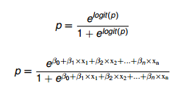
Logistic Regression
Transforming this equation into a probability we have:
From this we can find out the probability of particular events occurring.

Slide 9
Logistic Regression
We can directly interpret the coefficients in the logistic regression model in the following way:
A 1 unit increase in x_i (with all other variables held constant) is associated with a multiplicative change in the odds of success by the factor of exp(b_i) holding all other variables constant. This will be true when x_i is numeric.
In R, a one-zero coding is used for categorical predictors, so exp(b_i) is the predicted multiplicative change in the odds of success when changing to the x_i as “the 1” category from the baseline category when holding all other variables constant.

Slide 10
Logistic Regression
Inference in logistic regression works very similar to in multiple linear regression. However, inference is not generally useful in big data cases. We are more interested in our accuracy of prediction and model fit. With enough data all the predictors are ‘useful.’
In R, we would use:
glm(y~x1+x2+…, family= binomial(link=logit))
summary(glm(y~x1+x2+…, family= binomial(link=logit))

Slide 11
Logistic Regression
When we use logistic regression for ML, we will check our model fit based on how well it predicts. However, in many cases we justify model fit to our data based on the residual deviance.
Null deviance tells us how much points deviate when there is only an intercept in the model. Residual deviance tells us how much points deviate when all the predictors in the model.
The residual deviance follows a chi-squared distribution with the
df = number of groups – number of parameters in the model.
If this chi-squared statistic is significant – that is, it has a probability of less than 0.05 in the top right tail, this suggests that our model does not adequately fit the data. We then might want to try a transformation or more complex model.

Slide 12
Labs Regarding lm and glm
Do Labs on these two topics.
Lm data:
?iris
Glm data:
cuse.txt - Here are the contraceptive use data showing the distribution of 1607 currently married and fecund women interviewed in the Fiji Fertility Survey, according to age, education, desire for more children and current use of contraception.

Slide 13
Decision Trees
Decision trees can be used to classify categorical outcomes or quantitative outcomes.
For categorical, we call these ‘classification trees’
For quantitative, we call these ‘regression trees’
We can have any types of predictors: quantitative or categorical.
Supervised learning technique that is simple to build and understand.
‘The aim of a decision tree is to divide a multidimensional space for predictor variables into non-overlapping, multidimensional rectangles in such a way that the values for the response variable in each rectangle are as homogeneous as possible.’

Slide 14
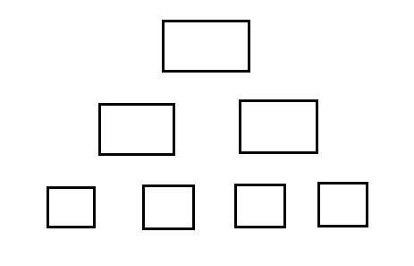
Decision Trees
Classification Tree Example:
Consider we want to build a decision tree to identify whether or not an individual will buy our product.
All customers is called the root node, and is at Level 0.
The split creates Level 1 – these are called interior nodes.
Then another split creates Level 2 – these are called leaf nodes.
Sometimes, you will see parent-child nodes.
All Customers
Time>30min
Time<30min
Female
Male
Male
Female
Yes
No
Yes
No

Slide 15
Decision Trees
The level 1 split has more homogeneous information in the split than the level 2 split.
Pruning/Trimming is when we take away splits in the higher levels.
If we do not prune/trim, then these models often over-fit the training data.
2 Labs on Regression and Classification Trees. Here are two different R library description pages for classification trees:
http://cran.r-project.org/web/packages/tree/tree.pdf
http://cran.r-project.org/web/packages/rpart/vignettes/longintro.pdf

Slide 16
Linear and Quadratic Discriminant Analysis (LDA and QDA)
Linear and Quadratic Discriminant Analysis are additional approaches to predict a categorical response using continuous predictors.
These approaches are logically straightforward. The goal is to plot our points in whatever space our predictors place them in – two predictors => 2 dimensional space, 3 predictors => 3 dimensional space.
We then slice the through the points dividing them into the most homogeneous groups possible - using lines (lda) or curves (qda).
If a new point falls into the same space, we would predict it’s category to be the same as the points in the same space.

Slide 17
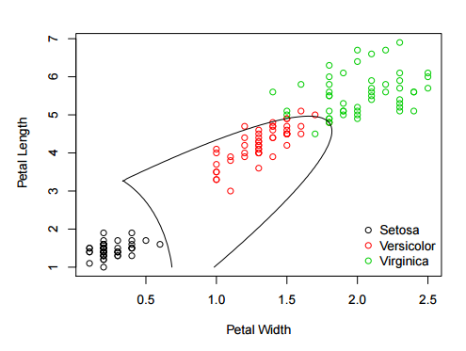
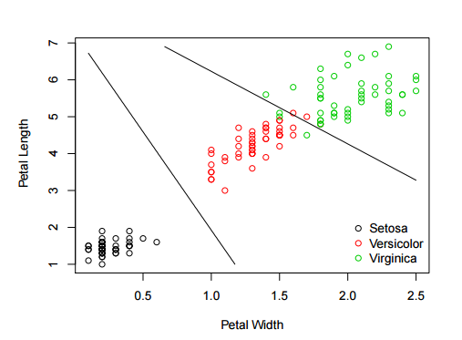
LDA and QDA

Slide 18
K-Nearest Neighbors (kNN)
K-Nearest Neighbors is an approach for predicting which category an observation belongs.
Like the name suggests, this approach predicts a response based on looking at the categories that are near to them.
The ‘k’ is how many neighbors they look at: k=2 closest points? 3 closest points? More? Less?
If the nearest points differ, they will choose the category that has the greatest proportion within the nearest neighbors.

Slide 19
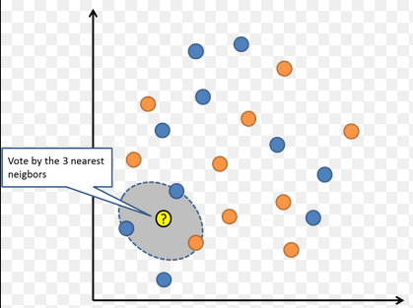
K-Nearest Neighbors
Example
The image below shows a two dimensional image of how we would use k-Nearest Neighbors.
One downfall of this method is when you do not have an equal number of observations in each class.
Often a weight is applied, so that the closest points are considered to influence the outcome more than the farther points.
For any of the methods, it is common to standardize the data – subtract the mean and divide by the standard deviation. This puts all of the data in a unit-less quantity (this can be done with scale()). Often the log of variables is also taken.

Slide 20
LDA, QDA, kNN
Given the nature of these algorithms, you may try a number of different explanatory variables. With kNN you may try a number of different neighbors.
Do Lab on these three topics.

Slide 21
Neural Networks
Neural networks are often called a ‘black box’ procedure based on the complicated, sophisticated nature in which a response is calculated.
In the case that you are interested in this procedure, you can learn more here: https://www.youtube.com/watch?v=bxe2T-V8XRs. An understanding of linear algebra, differential equations (involving partial derivatives), and calculus are necessary to fully grasp the algorithm.
I will not be discussing neural networks in R. However, the following video provides a method for conducting this algorithm: https://www.youtube.com/watch?v=lTMqXSSjCvk.

Slide 22
Naïve Bayes
This procedure predicts using Bayes' Rule to update a posterior probability.
The naïve assumption is one that assumes conditional independence. This assumption is provided in most Markov Stochastic Processes. The assumption does not usually hurt our ability to predict.

Slide 23
Naïve Bayes
Example
Consider we are interested in classifying a message as ‘spam’ or ‘not spam’ using the Naïve Bayes method.
We might determine the probability of an email being spam based on the words that exist within the message.
Here is a small example:
Text | Spam
send us your review | Yes
send us your review | No
review your password | No
review us | Yes
send your password | Yes
send us your account information | Yes

Slide 24



Naïve Bayes
Notice the probability of spam up front is 2/3 – that is P(spam) = 4/6.
However the probability of spam could be conditioned on the words found in the message.
We could then use these words to determine the probability that a new message is spam based on the conditional probability.
W is a particular word, say ‘us’
S is ‘spam’, H is ‘no spam’
Text | Spam
send us your review | Yes
send us your review | No
review your password | No
review us | Yes
send your password | Yes
send us your account information | Yes

Slide 25
Naïve Bayes
We could use this technique to determine the probability that an email is spam across a number of different words.
The algorithm would ask ‘What is the probability of spam given all of these things are true?’ and provide a probability of spam using Bayes’ Theorem.
If the message has a posterior probability of greater than a 50% chance of being spam, we would categorize it as spam.
For words or phrases not in an training set, we would ignore these words in a new message. The algorithm would do its best with words and phrases for which it was trained.
The Naïve Bayes algorithm often works well for non-linearly separable groups.

Slide 26
Naïve Bayes
It may be worth noting that the Naïve Bayes algorithm is very similar to the idea of Monte Carlo Markov Chains (MCMC).
Additional Links to this information can be found here:
http://joshwalters.com/2012/11/27/naive-bayes-classification-in-r.html
http://www.inside-r.org/packages/cran/e1071/docs/naiveBayes
https://en.wikibooks.org/wiki/Data_Mining_Algorithms_In_R/Classification/Na%C3%AFve_Bayes
http://www.cs.upc.edu/~belanche/Docencia/mineria/English-september-2008/Practical-work/Labo-NBayes-kNN.R

Slide 27
Support Vector Machines (SVM)
Support Vector Machines were originally designed for binary classification (much like logistic regression problems).
Since the original design of SVM, there have been updates to the packages in R to use similar mathematical logic for classifying beyond two groups as well as for prediction of numeric response variables. These are specified in the last link below.
Support Vector Machines work similar to the techniques of LDA and QDA, but are even more flexible in their ability to separate groups. This is shown in the first link below.
The mathematics behind SVM is a bit rigorous, but for those interested, it is provided in the second link below.
https://www.youtube.com/watch?v=9NrALgHFwTo
https://www.youtube.com/watch?v=1NxnPkZM9bc
http://cran.r-project.org/web/packages/e1071/vignettes/svmdoc.pdf

Slide 28
Support Vector Machines (SVM)
General Motivation
We want to split groups using a ‘hyperplane.’ This is also often called a linear classifier. The best hyperplane is the one that represents the largest separation between the two groups you are hoping to divide. We choose the hyperplane such that the distance to the nearest point is maximized.

Slide 29
Machine Learning and Modeling Notes
It has been shown that a simple model (only the most useful predictors chosen) along with bagging, cv, and/or boosting algorithms will perform much better than a method with multiple predictors.
Use what you know about the subject matter in terms of potential interactions and how classes may be determined to produce a model that makes sense. This model will likely perform better on new data.
Often we can get insight from our model that is intuitive in hindsight.

Slide 30
Unsupervised Techniques

Slide 31
K-means
Note that k-means and k-nearest neighbor algorithms are different! Knn is a supervised learning technique. K-means is an unsupervised technique. The goal of each is different.
The k-means technique takes ‘k’ centers and clusters points that are closest to each center at the end of the algorithm together.
The algorithm:
Randomly choose a spot for each of your ‘k’ centers.
Measure the distance from each center to each point.
Assign each point to the closest center.
Calculate a new center for the group.
Re-evaluate closest points (step 2).
Repeat until convergence.

Slide 32
K-means

Slide 33
K-means

Slide 34
K-means

Slide 35
K-means Eventually….

Slide 36
Principal Component Analsysis (PCA) and Factor Analysis
In terms of a simple rule of thumb, I'd suggest that you:
Run factor analysis if you assume or wish to test a theoretical model of latent factors causing observed variables.
Run principal component analysis If you want to simply reduce your correlated observed variables to a smaller set of important independent composite variables.

Slide 37
Principal Component Analsysis (PCA) and Factor Analysis
Run factor analysis if you assume or wish to test a theoretical model of latent factors causing observed variables.
What does this mean?
This type of modeling is frequently done in surveys where a researcher wants to narrow the number of questions to a smaller group of questions that are just as meaningful.
The researcher will show that certain questions are all linked to a single factor by observing the data collected from each question.
The researcher may then narrow the number of questions by only choosing 1 (or at least fewer) question(s) linked to that factor. In many cases, you are solidifying that particular questions are related to underlying idea of the survey.

Slide 39
Recommendation Engines

Slide 40
Recommendation Engines
These methods are aimed to help us make predictions when we don’t have a lot of information about an individual. We recommend based on individuals that are similar.
Affinity Analysis/Market Basket Analysis
Collaborative Filtering

Slide 41
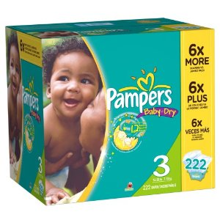


Affinity Analysis or Association Rules Used in Market Basket Analysis
Affinity Analysis or MBA is a measure of how likely products are to be purchased together in the same transaction or ‘Basket.’

Slide 42
Affinity Analysis
Support: The fraction of ‘claim supported’ receipts from all receipts in your dataset. Closer to 1 suggests many of this claim in the dataset.
Confidence: The fraction of ‘claim supported’ receipts from all receipts in which it was possible for the claim to be supported. Closer to 1 means this rule is more likely to happen, with 1 being it always happens.
Lift: How well our rule does compared to a random classification. Larger values indicate we are predicting well using our claim.
Support and Confidence are between 0 and 1. Lift is between 0 and infinity.

Slide 43
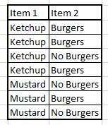
Affinity Analysis
Example:
Rule is that if an individual buys ketchup they also buy burgers.
Support:
Confidence:
Lift:
Note: The lift here indicates a ration that suggests ketchup and burgers are bought together, and buying ketchup doesn’t associate with buying other items.

Slide 44
Affinity Analysis
Example:
Rule is that if an individual buys ketchup they also buy burgers.
Support: 3/7
Confidence:
Lift:
Note: The lift here indicates a ration that suggests ketchup and burgers are bought together, and buying ketchup doesn’t associate with buying other items.

Slide 45
Affinity Analysis
Example:
Rule is that if an individual buys ketchup they also buy burgers.
Support: 3/7
Confidence: 3/4
Lift:
Note: The lift here indicates a ration that suggests ketchup and burgers are bought together, and buying ketchup doesn’t associate with buying other items.

Slide 46
Affinity Analysis
Example:
Rule is that if an individual buys ketchup they also buy burgers.
Support: 3/7
Confidence: 3/4
Lift: (3/4)/(4/7)
Note: The lift here indicates a ration that suggests ketchup and burgers are bought together, and buying ketchup doesn’t associate with buying other items. It is considered a better measure than using confidence, because it considers not only confidence, but all the data.
*R Lab*

Slide 47
Collaborative Filtering (CF)
How should we predict movies, books, products, etc. to a customer?
We can use MBA to suggest products based on previous products, but how do we know what the customer will like?
Maybe they purchased a product, but they didn’t like it.
Collaborative Filtering might be our best option for making predictions.

Slide 48
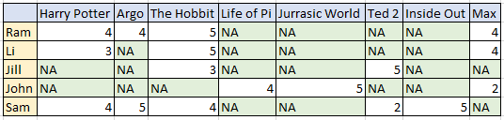
Collaborative Filtering
How do we predict NA values?
Two Methods
User based nearest neighbors
Item based nearest neighbors

Slide 49
Collaborative Filtering
User-Based CF
Find the similarity between individuals (or dissimilarity).
Choose individuals who are related (either positive or negative).
If the similar or dissimilar individuals have a value for some movie, use it to predict for the one’s that don’t.

Slide 50
Collaborative Filtering
Item-Based CF
Find the similarity between items (or dissimilarity).
Choose items that are related (either positive or negative).
If the similar or dissimilar items have a value for some movie, use it to predict for the one’s that don’t.

Slide 51
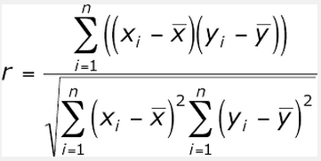
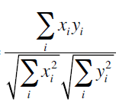
Collaborative Filtering
How to judge similarity of individuals?
Generally, we compute a correlation coefficient between individual’s, and use it as a weight
different units same units
OR

Slide 52
Collaborative Filtering
User-Based CF
For user-based, we would compute the correlation between all users. One example is:
Corr(Ram, Li) = (4*3+5*5+4*4)/(sqrt(4²+5²+4²)sqrt(3²+5²+4²) ) = 0.903

Slide 53
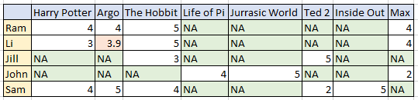
Collaborative Filtering
User-Based CF
Then we could predict Argo for Li as:
Pref(Li, Argo) = 0.993*4 = 3.972
In practice, we might use the sum of a bunch of weighted ratings for similar and dissimilar users.

Slide 54
Collaborative Filtering
Item-Based CF
For user-based, we would compute the correlation between all users. One example is:
Corr(HP, Hob) = (4*5+3*5+4*4)/(sqrt(4²+3²+4²)sqrt(5²+5²+4²) ) = 0.903

Slide 55

Collaborative Filtering
User-Based CF
Then we could predict Harry Potter for Jill as:
Pref(Li, Argo) = 0.903*3 = 2.7
In practice, we might use the sum of a bunch of weighted ratings for similar and dissimilar items.

